Slide 1

Technical Presentation
SVBRDF Estimation using a Physically-based Differentiable Renderer Markus Andreas Worchel

Slide 2
Recap

Slide 3
SVBRDF
Introduce SVBRDF Model (Normals, Diffuse Albedo, Specular Albedo, Roughness)
Explain Diffuse/Specular

Slide 4
SVBRDF
Single-View Paper
Multi-View Paper
Explain rough idea
Mention that they use machine learning

Slide 5
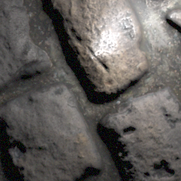
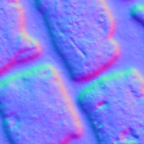
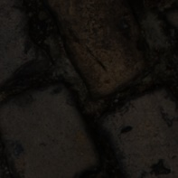
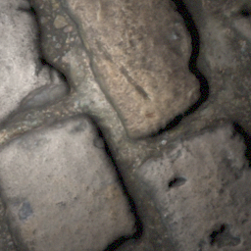
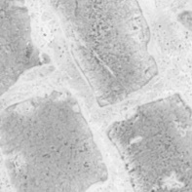
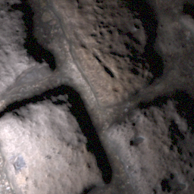

Network
Fusion
Generator
Normal
Diffuse Albedo
Generator
Roughness
Generator
Specular Albedo

Slide 6
Network – Generator

Slide 7
Network – Multi-View Fusion

Slide 8
Rendering Loss

Slide 9
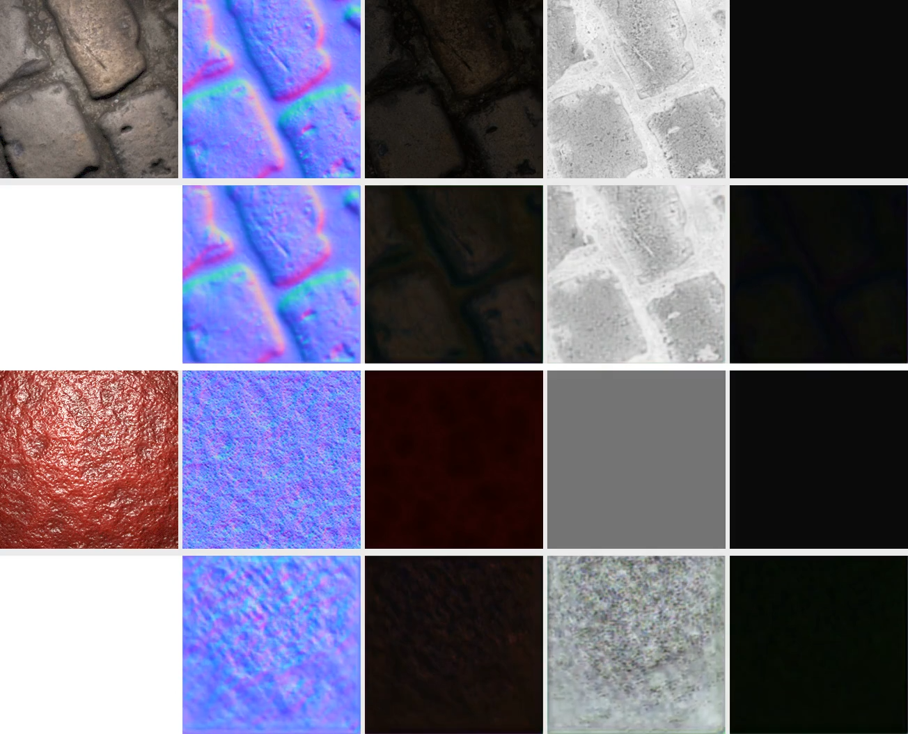
Current State – Generator
Generator reimplemented in PyTorch
Overfitting test
2 training samples (only one shown (top))
1 test sample (bottom)
Lighting: 3 color channels per target image -> 12
Lighting: Simple L1 loss

Slide 10
Schedule
Download database
Acquire testing and training code for the network
Contact authors for training code
Fallback: Re-implementation
Acquire code for Mitsuba 2
Not yet officially released
Fallback: Use other renderer like render (Li et al., 2018)
Get familiar with papers, source code and data
Replace rendering layers of the network with Mitsuba 2
Evaluation (compare with unmodified method)

